Slide 1
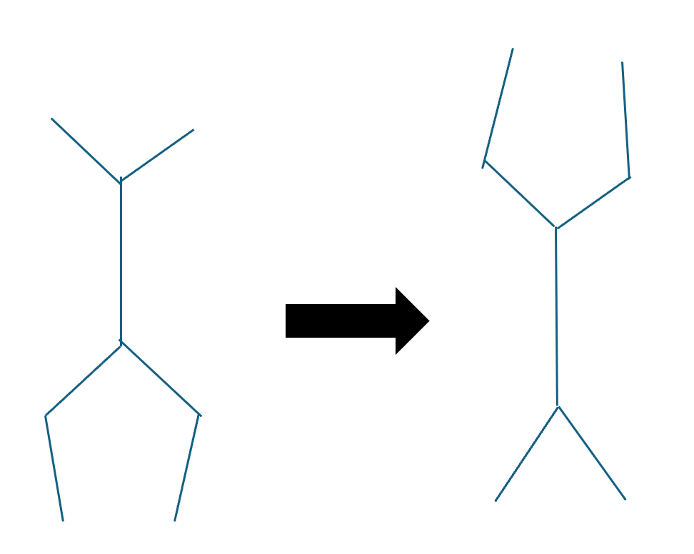
Handstand Robot
Jason Abi Chebli, Andrew Tai, Eric Chuang, Eric Foss
Goals
  Create a 7-link robot that can go from standing to handstand
  This will be done using classical controls as well as reinforcement learning
  A comparison between the efficiency, torque inputs will be done
Stretch Goal (if any)
  After achieving a handstand, make the robot walk forward on its hands

